Slide 1














FACE RECOGNITION
ATTENDANCE
SYSTEM
TEAM - 11

Slide 2
FINAL REVIEW
TEAM MEMBERS
LOGESHWARAN V V (2118125)
SEDHU RAM P (2118138)
SRIDHAR E (2118145)
TAMIZHARASU M (2118L10)
PROJECT GUIDE
DR.R.DEVI M.Tech.,PhD.,

Slide 3
PROBLEM STATEMENT
Current attendance systems, relying on manual methods like paper-based records and outdated technologies such as punch cards or RFID tags, are prone to significant inefficiencies. These methods are often error-prone and can be easily manipulated, leading to inaccuracies.ID cards or RFID tags can be lost, damaged, or misused by others. This results in unreliable attendance tracking and frequent data inaccuracies. An efficient, automated solution is needed to address these limitations.

Slide 4
EXISTING SYSTEM
Attendance System | Advantages | Disadvantages
Manual Attendance Marking | Simplicity: No need for special equipment, only pen and paper. Customizable: Easily adapted to various attendance policies. | Error-prone: High risk of human error or tampering (proxy attendance). Inefficient: Difficult to track and analyze for large attendance data

Slide 5
EXISTING SYSTEM
Attendance System | Advantages | Disadvantages
Biometric Attendance Marking | Biometric Attendance Marking | Biometric Attendance Marking
Fingerprintbased | Highly Accurate: Unique fingerprint ensures authenticity. Fast: Quick scanning process. | Hygiene Issues: Frequent contact with devices can lead to hygiene concerns. False Negatives: Dirty or wet fingers can cause false rejections. Expensive: Requires specialized equipment for scanning and software integration. Proxy Attendance: Making fake fingerprint leads to false entries

Slide 6
EXISTING SYSTEM
Attendance System | Advantages | Disadvantages
Facial Recognition | Contactless: No physical contact required, making it hygienic. Convenient: Fast and automatic marking once the face is detected. High Accuracy: Advanced algorithms can detect faces even in different lighting conditions. | Environmental Limitations: Poor lighting or extreme angles may affect recognition. Privacy Concerns: Storing facial data raises privacy and security issues. False Positives/Negatives: Can have difficulty distinguishing between similar faces or detecting masks/hats.
Iris/Retina Scan | Highly Secure: Iris or retina patterns are more unique than fingerprints. Contactless: Eliminates hygiene concerns. | Expensive:Requires advanced, costly hardware. User Discomfort: Some users may find it uncomfortable to scan their eyes.

Slide 7
EXISTING SYSTEM
Attendance System | Advantages | Disadvantages
RFID-based Attendance | RFID-based Attendance | RFID-based Attendance
Card Swipe | Low Cost: Simple technology that’s widely available. Easy to Implement: Simple setup process. Reliable: Can handle a large number of users with minimal error | Lost or Damaged Cards: Users may lose their RFID cards, and they can be easily damaged. Proxy Attendance: Cards can be shared, leading to buddy punching. Maintenance: Readers may require regular maintenance.

Slide 8
EXISTING SYSTEM
Attendance System | Advantages | Disadvantages
QR Code-based Attendance | Easy to Implement: Users only need a smartphone and a QR code scanner. Contactless: No physical contact, making it hygienic. Low Cost: No need for specialized hardware except a smartphone camera. | Dependence on Smartphones: Users without smartphones are excluded. Cheating: QR codes can be shared or replicated. Slower for Large Groups: Scanning QR codes for large groups can take time.
OTP-based Attendance | Secure: Each login is authenticated with a one-time password. No Specialized Equipment: Users only need access to a phone or email. | Manual Entry: Requires users to enter an OTP, which can be slower than other methods. Dependence on Connectivity: Requires network access to receive OTPs. Potential Delays: Delay in OTP delivery can slow down attendance marking

Slide 9
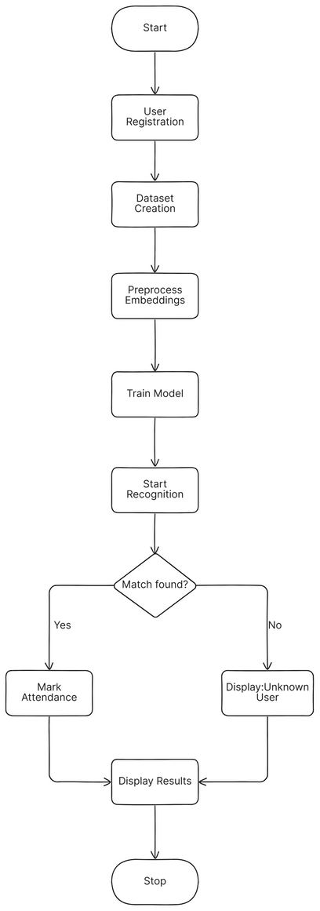
PROPOSED SYSTEM FLOWCHART
OVERALL ARCHITECTURE

Slide 10
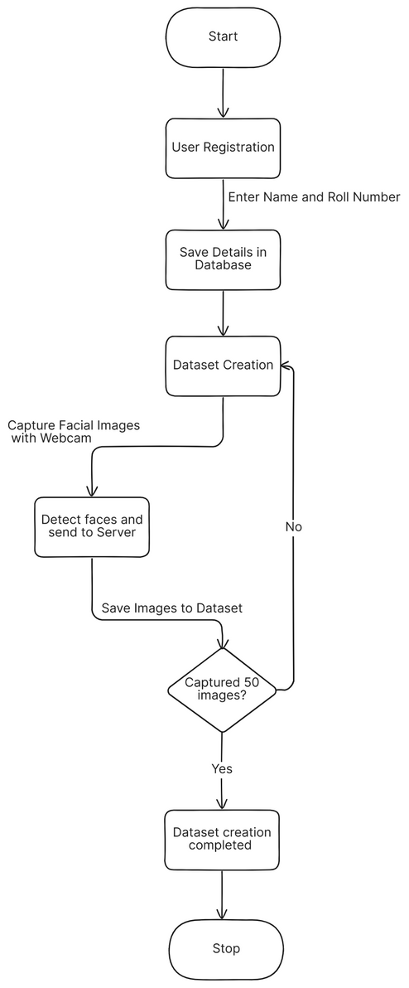
PROPOSED SYSTEM FLOWCHART
DATASET CREATION

Slide 11
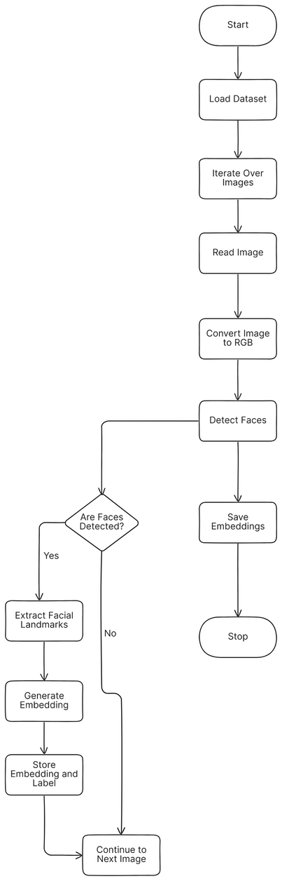
PROPOSED SYSTEM FLOWCHART
PREPROCESS IMAGE TO EMBEDDINGS

Slide 12
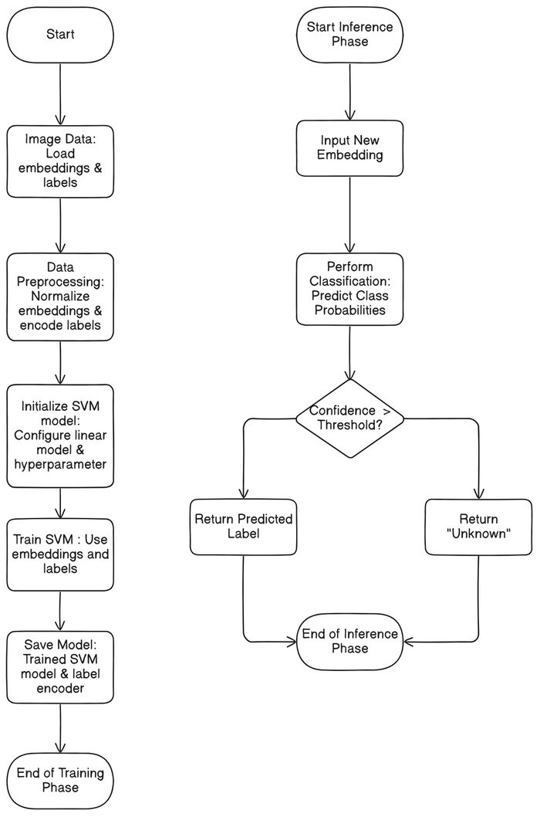
PROPOSED SYSTEM FLOWCHART
SVM ARCHITECTURE

Slide 13
ALGORITHMS USED:
Face Detection : BlazeFace in Tensorflow.js
Image preprocessing : OpenCV
Face Shape Predictor : Dlib’s 68 Landmark Predictor
Face Embedding Extraction : Dlib’s ResNet-based Face Recognition Model
Face Recognition : Support Vector Machine (SVM) Classifier
Frontend : HTML,CSS,JS
Backend : Python flask
Database : MYSQL

Slide 14
PROPOSED SYSTEM
MODULES
User Interface Module
Create Dataset
Preprocess Embeddings
Train Model
Start Recognition
View Attendance
View Registered Students
Export Attendance

Slide 15
1.USER INTERFACE MODULE
Purpose:
The starting point of the application, acting as a navigation hub for all the functionalities.
Description:
The home page provides an intuitive and user-friendly interface, allowing users to navigate through various features such as dataset creation, preprocessing embeddings, training the model, and recognizing faces.
Each functionality is displayed as a card with an icon and description for easy identification.
Designed using Bootstrap for responsiveness and visual appeal.
Accessible actions include: Create Dataset, Preprocess Embeddings, Train Model, Start Recognition, View Attendance, View Registered Students, Export Attendance.

Slide 16
2.CREATE DATASET MODULE
Purpose:
Enables registration of new students by capturing their facial images.
Description:
This module provides a form where the user inputs their name and roll number.
Upon submission, the frontend captures multiple images of the user via the webcam to create a dataset and the images are stored in a designated server directory, categorized by the user’s unique roll number.
Key Features:
Ensures that all required fields (name and roll number) are filled before submission.
Captures images in a systematic format for easy labeling.
Uses webcam integration for real-time image capture.
Technologies Used:
HTML,Bootstrap and JS for the frontend form.Tensorflow.js for for face detection.
Flask or similar backend frameworks for processing data and opencv for processing images

Slide 17
3.PREPROCESS EMBEDDINGS MODULE
Purpose:
Processes the collected facial images to generate embeddings, a prerequisite for model training.
Description:
This module prepares the dataset by using a pre-trained deep learning model (Dlib) to extract numerical embeddings from the captured images.
These embeddings represent the unique features of each individual’s face and are saved for model training.
Key Features:
Automates the conversion of raw images to embeddings.
Ensures embeddings are labeled correctly for training.
Backend Functionality:
Reads images from the dataset directory.
Extracts embeddings using a face detection and feature extraction library.
Saves embeddings in a structured format (pickle file).

Slide 18
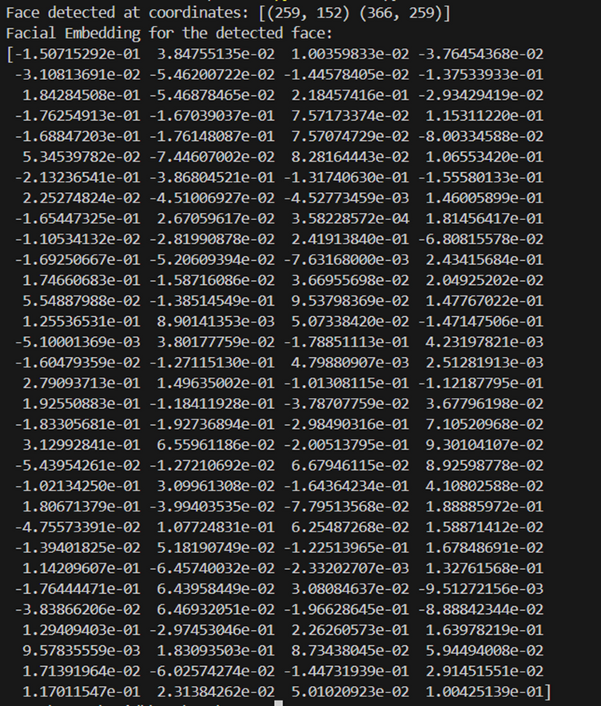
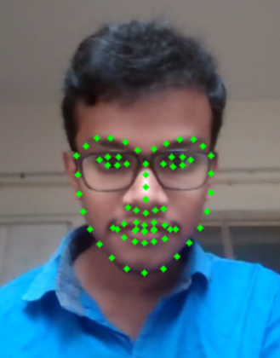
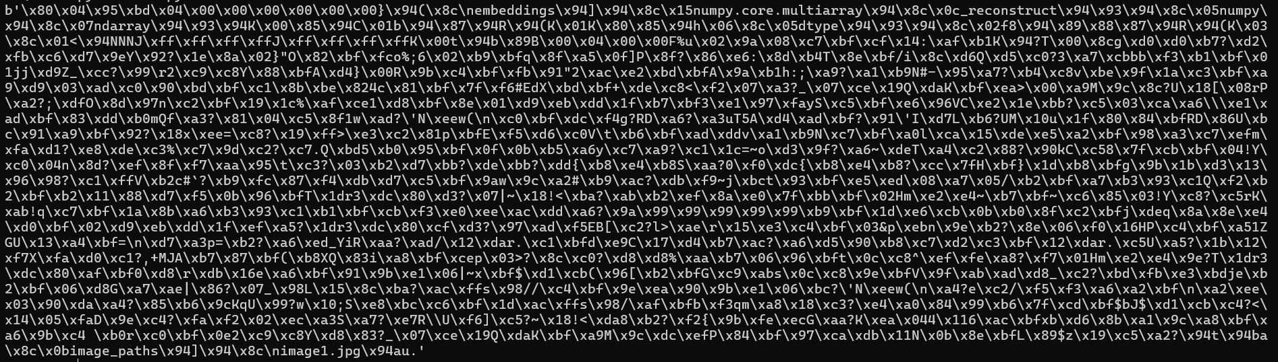
3.PREPROCESS EMBEDDINGS MODULE
Storing Embeddings in pickle file
Landmark detection
Embedding Generation

Slide 19
4.TRAIN MODEL MODULE
Purpose:
Trains a machine learning classifier using the preprocessed embeddings.
Description:
Uses the embeddings generated in the preprocessing step to train a classification model Support Vector Machine (SVM).
The trained model is capable of distinguishing between individuals in the dataset.
Key Features:
Automates the training process.
Saves the trained model for real-time recognition.
Backend Functionality:
Loads embeddings and their labels.
Splits the data into training and testing sets for evaluation.
Trains the classifier and evaluates its performance (e.g., accuracy or precision).

Slide 20
5.FACE RECOGNITION MODULE
Purpose:
Identifies registered users in real-time using a live webcam feed and records their attendance.
Description:
Streams live webcam footage, detects faces, matches them with registered users, and records attendance with timestamps for recognized faces.
Key Features:
Real-time recognition with visual feedback.
Automatic recording of attendance upon successful recognition
Frontend Functionality:
Detect faces in the webcam using blazeface model.
Captures images and send to backend for processing.
Backend Functionality:
Uses the trained model to predict the identity of detected faces.
Records attendance in the database or a file.

Slide 21
6.ATTENDANCE RECORDS MODULE
Purpose:
Provides a tabular view of attendance records for all users.
Description:
Displays the list of all attendance entries with the user’s name and timestamp.
Features a table for easy viewing of large datasets.
Allows users to navigate back to the home page for further actions.
Backend Functionality:
Queries the attendance database or file for records.
Renders the data dynamically using Flask and Jinja2 templates.

Slide 22
7.REGISTERED STUDENTS MODULE
Purpose:
Displays a list of all students registered in the system.
Description:
Provides a table with student details, including serial number, name, roll number, and registration date.
Ensures users can view all individuals whose datasets have been created.
Features a "Back to Home" button for navigation.
Backend Functionality:
Fetches and displays student data from the database or a directory structure.

Slide 23
8.EXPORT ATTENDANCE MODULE
Purpose:
Allows exporting of attendance data as a CSV file for reporting or integration.
Description:
Features a "Download CSV" button to export attendance data.
Generates a structured CSV file with columns for Name, Roll Number, and Timestamp.
Backend Functionality:
Reads attendance records from the database.
Formats the data into CSV format using libraries like CSV.
Provides the file for download.

Slide 24
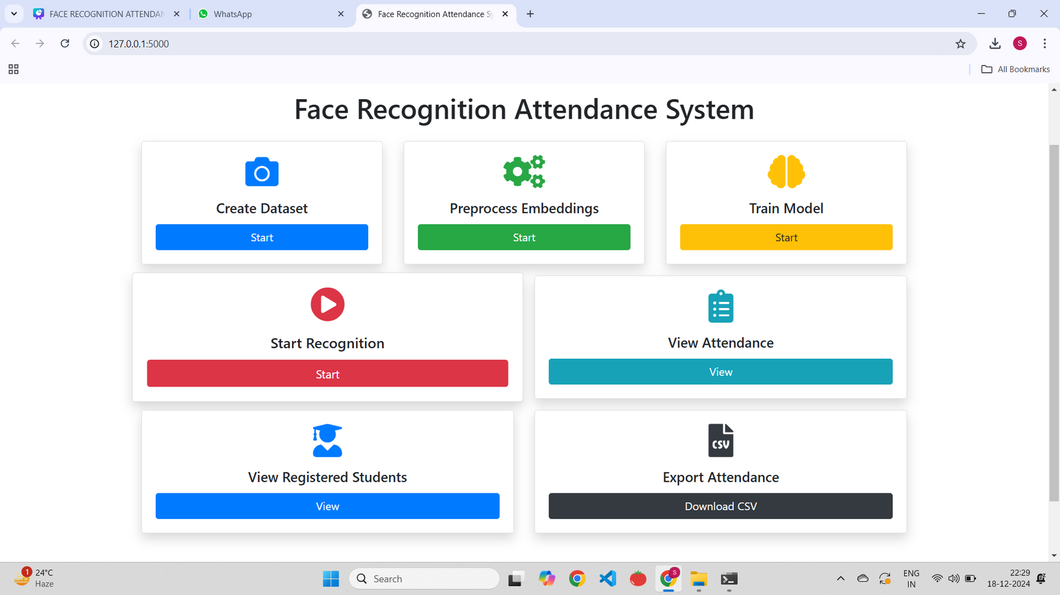
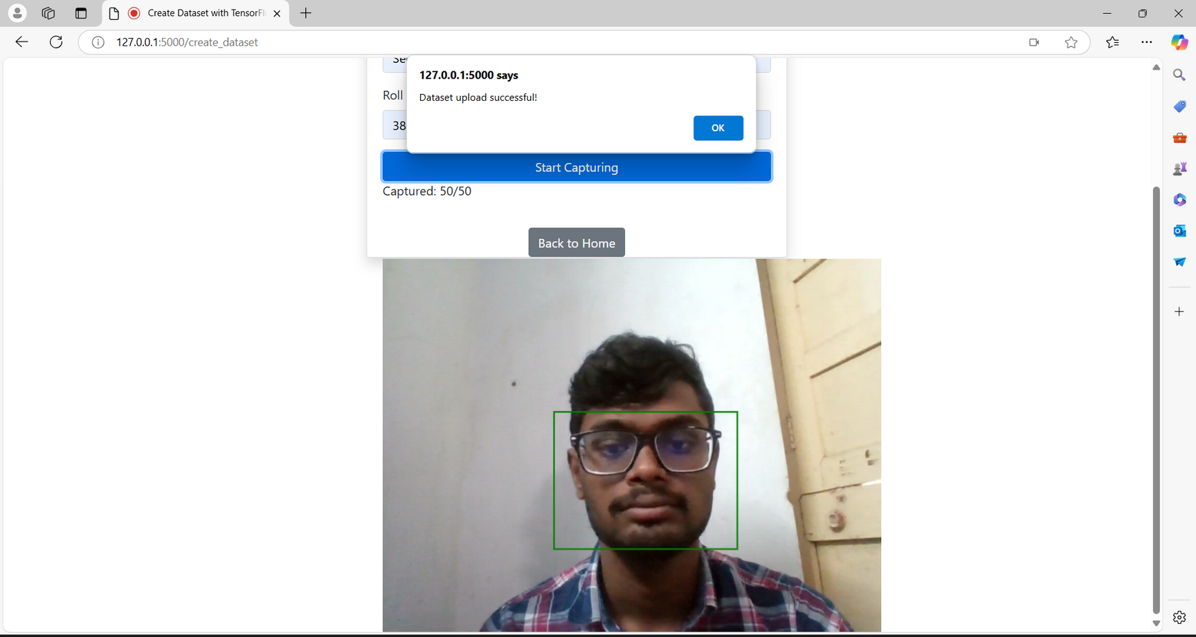
OUTPUT
Home Page
Dataset Creation

Slide 25
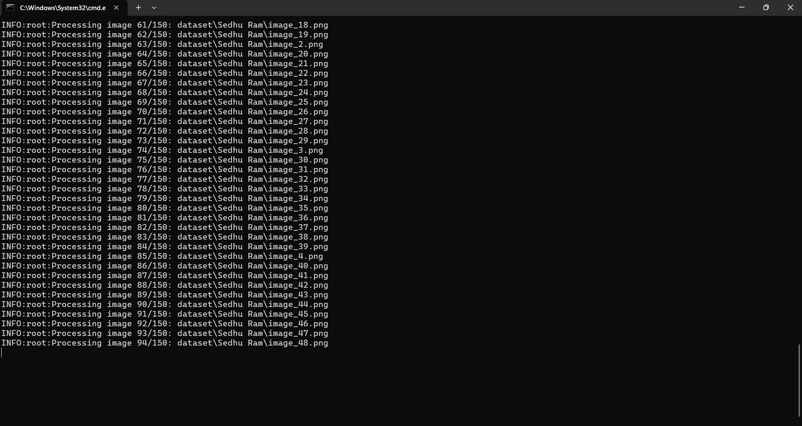
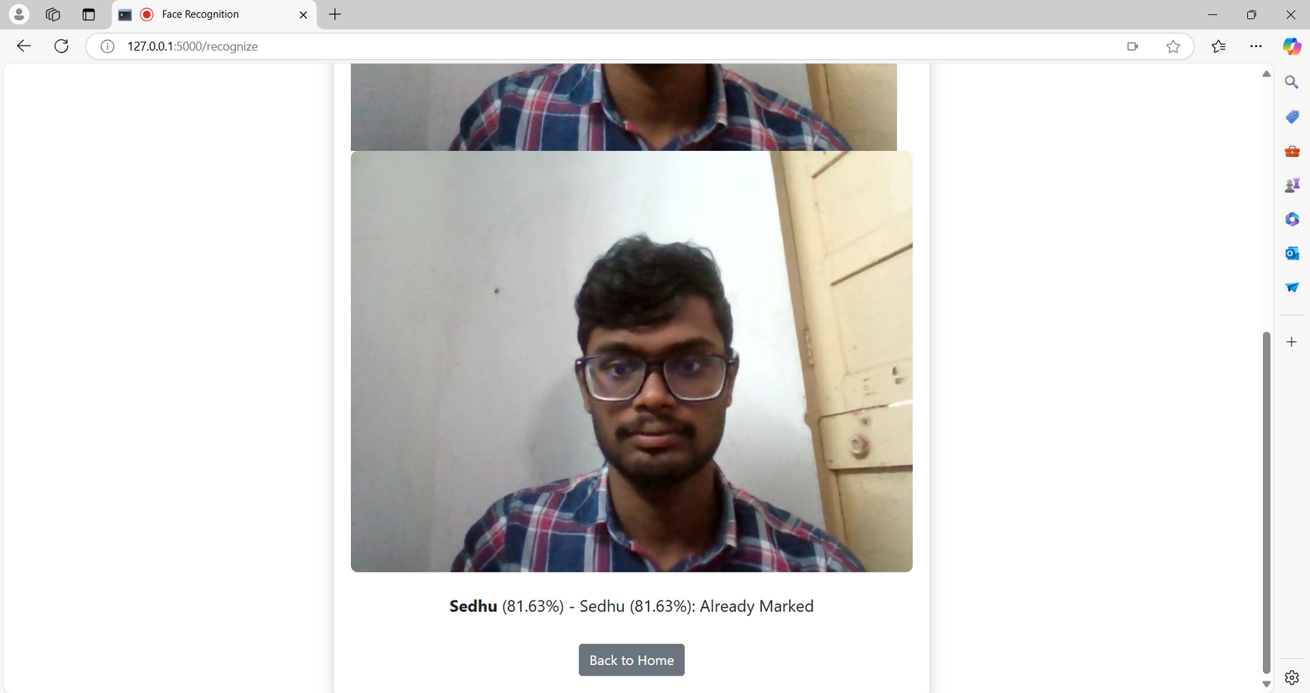
OUTPUT
Preprocessing Embedding
Face Recognition and Attendance Marking

Slide 26
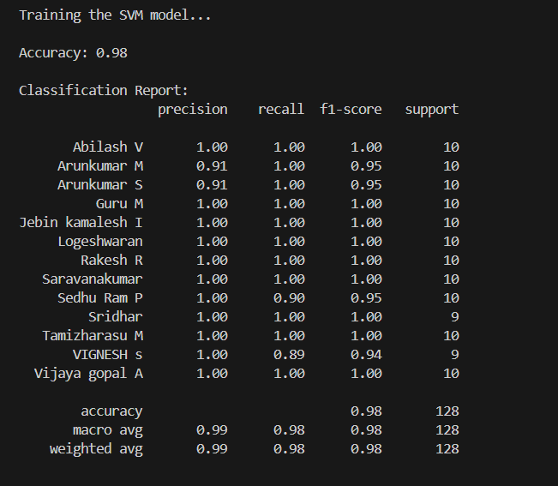
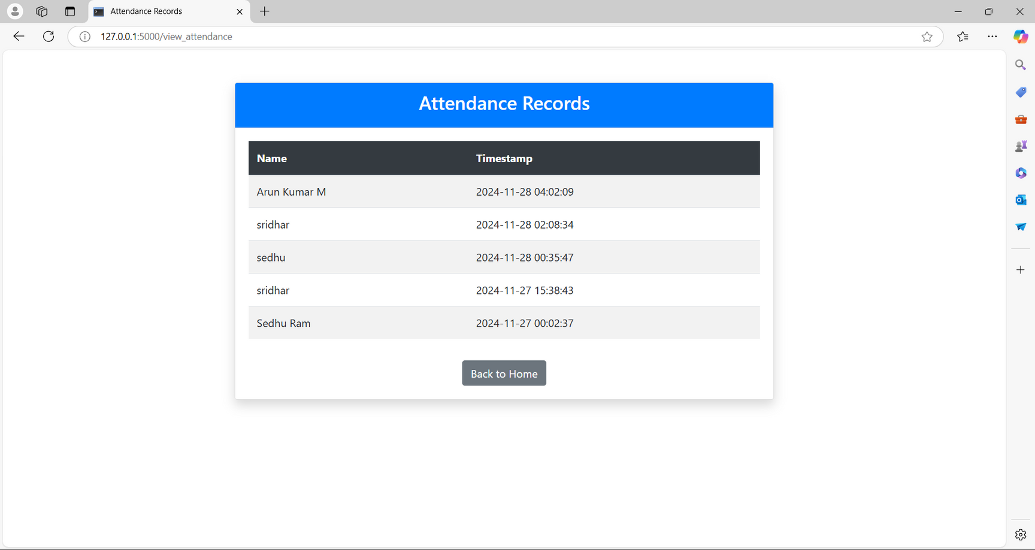
OUTPUT
Attendance Records
Accuracy

Slide 27
REFERENCES
[1]Muhammad Haikal Mohd Kamil, Norliza Zaini, Lucyantie Mazalan, Afiq Harith Ahamad – 2023 “Online attendance system based on facial recognition with face mask detection”, Springer, vol 82, pp. 34437–34457
[2]Dr. Sarita Sanap,Ms. Sakshi Narwade,Mr. Sahil Goge,Mr. Krishna Pandit - 2023 “Face Recognition Based Attendance System Using Histogram of Oriented Gradients and Linear Support Vector Machine”, EJTAS, vol 1, No.1,pp. 87
[3]Andre Budiman, Fabiana, Ricky Aryatama Yaputera, Said Achmad, Aditya Kurniawan – 2023 “Student attendance with face recognition (LBPH or CNN)”, ELSEVIER, vol 216, pp. 31-38
[4]Aditya UmalkarShivang Singh ManhasImazChandiwalaNarendra Bhagat -2023 “Face Recognition Based Attendance System Using Real Time Data”, IJCRT, vol 11, pp. 2320-2882

Slide 28
REFERENCES
[5]Ashish Kumar Shukla, Archana Shukla, Raghvendra Singh-2023 “Automatic attendance system based on CNN–LSTM and face recognition”, Springer, vol 16, pp. 1293–1301
[6]Olufemi S. Ojo , Mayowa O. Oyediran , Babatunde J. Bamgbade ID , Abidemi Emmanuel Adeniyi ID , Godwin Nse Ebong ID, and Sunday Adeola Ajagbe – 2023 “Development of an Improved Convolutional Neural Network for an Automated Face-Based University Attendance System”, PARADIGM Plus, vol 4, No.1, pp. 18-28
[7]Ahmad S. Lateef , Mohammed Y. Kamil -2023 “Face Recognition-Based Automatic Attendance System in a Smart Classroom”, IJEEE, vol 20, pp. 37-47
[8]Priyanka Manke, Mohammed Hamza Siddiqui, Himanshu Pednekar, Pawan Sakat, Qureshi Abdul Qadir-2024 “Facial Recognition-Based Attendance System”, IJISRT,vol 9, pp. 673-679

Slide 29
REFERENCES
[9]Ms. K. Vyshnavi,Suhel Shaik, Mylavarapu Santosh Kumar,M.S.V Praveen, Swetha Potti - 2024 “Facial Recognition-Based Attendance System Using Opencv”, JCSE , vol 2, pp. 1-10
[10] Dhanush Gowda H.L, K Vishal, Keertiraj B. R, Neha Kumari Dubey , Pooja M. R. – 2020 “Face Recognition based Attendance System”,IJERT, vol 9, pp. 761-767
[11] Dr. T. Chandrasekhar Rao, N. Sathvik Sharma, M. Mahammad Shadik, P. Usha Sree, P. Sri Harsha, K. Suryavardhan – 2024 “Automated Attendance System Using Facial Recognition”,IJSRST, vol 11, No.2, pp. 67-74

Slide 30
Thank you

